Slide 1

The Data Protection Act
ICT and the Law

Slide 2



Slide 3
Did you see anything wrong with that?
Most people wouldn’t want that sort of information posted in a public place. Why?
Because it is private and personal – nothing to do with anyone else.
In order to keep our details private, we need a Data Protection Act.

Slide 4
The purpose of the act
The Data Protection Act 1998 sets out to protect the privacy of personal information.
It only covers personal information about living individuals, not about businesses.
It covers data stored on computer or in a paper-based filing system.
It lets people check what data is being held about them.
It is run by the Information Commissioner’s Office.

Slide 5

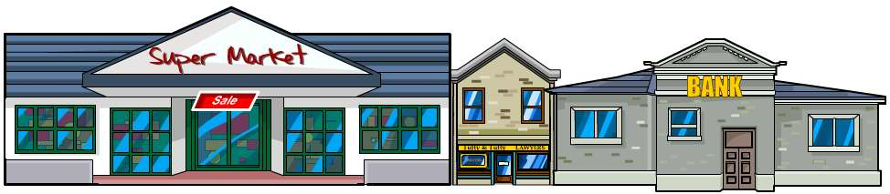
Subjects and users
Data subjects are people who have data held about them – just about everybody really.
Data users are the people or organizations who hold the data. There are far more data users than many people think.
An organization holding data has to have a data controller
– a person who makes sure the act is followed.

Slide 6

What do data users have to do?
They have to notify the Information Commissioner and say:
what data they want to store
what they want to use it for
how long they will keep it
who they might pass it on to.
They also have to agree to follow the eight Data Protection Principles.

Slide 7
It’s the principle of the thing
The act says that data must be:
fairly and lawfully processed (used)
used for limited purposes
adequate and relevant. Only what is needed may be used
accurate
not kept for longer than is necessary
accessible to the individual and able to be corrected or removed where necessary
secure
not transferred to countries without adequate protection.

Slide 8
What rights do data subjects have?
They have the right to:
see what data is being held about them if they ask the data user. They may have to pay to see it
change anything that is wrong
refuse to have some data stored at all, if it might cause damage or distress
refuse to allow processing for direct marketing – junk mail
complain to the Data Protection Commission if they think the rules have been broken
claim compensation if they can prove they have been caused damage by a data controller breaking the rules.

Slide 9
Do users always have those rights?
There are a few cases when the Data Protection Act does not apply. These are called exemptions to the Act. Here are a few of them:
national security – you cannot demand to see your data if national security is at stake
police investigations – information being used to prevent crime is not covered (though police records are)
examination results are exempt until they are published by the examining bodies.

Slide 10
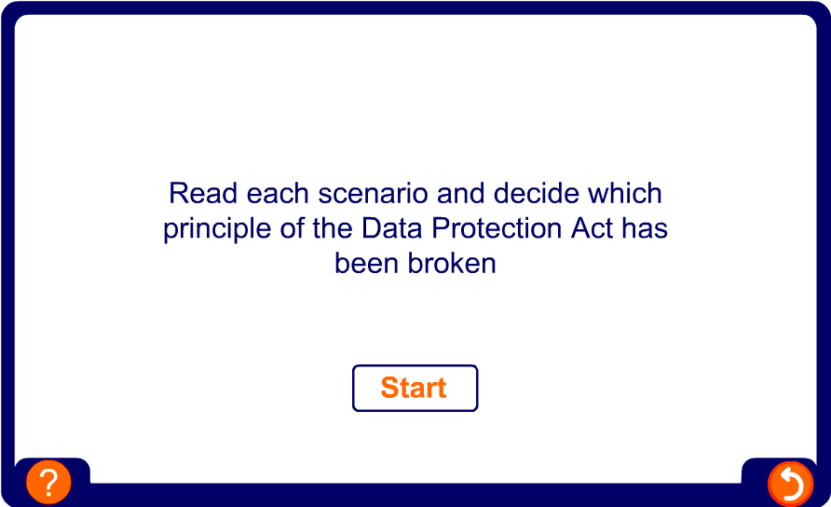
Oops, I broke it!

Slide 11

Summary
The Data Protection Act protects personal data from being abused.
Data users store information about data subjects.
Data users must register with the Data Protection Commission and follow the Data Protection Principles.
Data subjects have rights to see their data and change any errors.
There are some exemptions to the act, such as national security and police investigations.

